Slide 1
SIMATS ENGINEERING
ASSESSMENT TOOL 1: Experiments
Cloud Computing and COURSE CODE:
Big Data Analytics
COURSE NAME:
CSA1507
COURSE OUTCOME COVERED
CO3: Implement cloud-based solutions using cloud storage, web APIs, and platform services for real-world
applications. (BL3)
Dave's Taxonomy: Precision (Level 3) Question Count: 4
Total Marks: 40
Code of Conduct
I DIVYA.K (192511316) (Name / Reg No) certify that this submission is my original work and that I have adhered to the guidelines specified for this assessment.
I understand that any violation of academic integrity rules will result in disciplinary action. Signature of the student: DIVYA.K
Experiments Rubric
Criteria | Weightage | Level 4 - Exemplary | Level 3 - Proficient | Level 2 - Developing | Level 1 - Beginning
Experimental Design | 25% | Design is systematic and technically strong | Mostly correct design | Basic design with gaps | Poorly designed activity
Use of Tools / Platforms | 20% | Appropriate and effective use of cloud tools | Good tool usage with minor issues | Limited tool usage | Incorrect or missing tool usage
Application of Concepts | 20% | Concepts are applied accurately to practical tasks | Mostly accurate application | Partial application | Weak application
Analysis and Output | 20% | Strong analysis and meaningful outcome interpretation | Good analysis with minor gaps | Basic analysis | Little or no analysis
Documentation | 15% | Clear, structured, and complete documentation | Mostly complete documentation | Partially complete | Poor documentation
Total Marks Awarded:

Slide 2
Experiments
Experiment 1: Create a simple cloud software application for Hospital information system for SIMATS Hospital using any Cloud Service Provider to demonstrate SaaS with fields of patient name, age, address, phone, email, Attender name, attender phone, doctor name, diseases, etc.
Experiment 2: Create a simple cloud software application for online super market using any Cloud Service Provider to demonstrate SaaS with the template of customer name, address, phone, email, items, quantity etc. with the item classification form.
Experiment 3: Demonstrate virtualization by Installing Type-2 Hypervisor in your device, create and configure VM image with a Host Operating system (Either Windows/Linux). Create a Virtual Machine with 3 CPU, 10GB RAM and 10GB storage disk using a Type 2 Virtualization Software.
Experiment 4: Demonstrate virtualization by Installing Type-2 Hypervisor in your device, create and configure VM image with a Host Operating system (Either Windows/Linux). Create a Snapshot of a VM and Test it by loading the Previous Version/Cloned VM.

Slide 3
Experiment 1: Hospital Information System (SaaS)
Aim
To design and deploy a simple cloud-based (SaaS) Hospital Information System for SIMATS Hospital using a Cloud Service Provider, enabling patient registration and record management such as patient details, attender details, doctor assigned, and diagnosed disease, accessible over the internet through a browser.
Software / Cloud Resources Required
Cloud Service Provider account (AWS / Microsoft Azure / Google Cloud Platform — Free Tier)
Static web hosting (Amazon S3 Static Website Hosting / Azure Static Web Apps / Firebase Hosting)
Serverless backend (AWS Lambda + API Gateway, or Azure Functions, or Firebase Cloud Functions)
Cloud database (Amazon DynamoDB / Azure Cosmos DB / Firebase Firestore)
Web browser and a text editor (VS Code)
Database Fields — Patient Record Table
Field Name | Data Type / Description
Patient ID | String (Primary Key, auto-generated)
Patient Name | String
Age | Number
Address | String
Phone | String
Email | String
Attender Name | String
Attender Phone | String
Doctor Name | String
Disease / Diagnosis | String
Date of Admission | Date
Status | String — Admitted / Under Treatment / Discharged
Procedure
Create a free-tier account with the chosen Cloud Service Provider (this document uses AWS as an illustration).
Create a cloud database table named 'HospitalPatients' with 'PatientID' as the primary key, and add the attributes listed in the field table above.
Write a serverless function that exposes CRUD operations — Register Patient, Search Patient, Assign Doctor, and Update Status (Admitted/Under Treatment/Discharged).
Expose the function through API Gateway (or the equivalent HTTP trigger in Azure/GCP) to obtain a REST API endpoint.
Develop the front-end web page (HTML/CSS/JavaScript) shown below, which calls the REST API using fetch().

Slide 4
Upload the front-end files to an S3 bucket and enable Static Website Hosting (or deploy to Azure Static Web Apps / Firebase Hosting).
Set the bucket policy / hosting permissions to allow public read access so the application is reachable as a SaaS application over a URL.
Open the hosted URL in a browser, register sample patient records, and verify that doctor assignment and status updates work and reflect correctly in the cloud database.
This confirms the SaaS delivery model — the hospital information system runs entirely on the cloud provider's infrastructure and is accessed only through a browser, with no local software installation.
Sample Front-End Code (index.html)
<!DOCTYPE html>
<html lang="en">
<head>
<meta charset="UTF-8">
<title>SIMATS Hospital Information System</title>
<style>
body { font-family: Arial, sans-serif; margin: 30px; background:#f4f6f8; } h2 { color:#1f4e78; }
table { border-collapse: collapse; width:100%; background:#fff; }
th, td { border:1px solid #ccc; padding:8px; text-align:left; } th { background:#1f4e78; color:#fff; }
input, select { padding:6px; margin:4px; }
button { padding:6px 14px; background:#1f4e78; color:#fff; border:none; cursor:pointer; }
</style>
</head>
<body>
<h2>SIMATS Hospital - Patient Registration</h2>
<div>
<input id="pname" placeholder="Patient Name">
<input id="age" placeholder="Age" type="number">
<input id="address" placeholder="Address">
<input id="phone" placeholder="Phone">
<input id="email" placeholder="Email">
<input id="attName" placeholder="Attender Name">
<input id="attPhone" placeholder="Attender Phone">
<input id="doctor" placeholder="Doctor Name">
<input id="disease" placeholder="Disease">
<button onclick="addPatient()">Register Patient</button>
</div>
<table id="patientTable">
<tr><th>Name</th><th>Age</th><th>Phone</th><th>Attender</th>
<th>Doctor</th><th>Disease</th><th>Status</th><th>Action</th></tr>
</table>
<script>
const API = "https://<your-api-id>.execute-api.<region>.amazonaws.com/patients";
async function loadPatients() { const res = await fetch(API); const patients = await res.json();
const table = document.getElementById("patientTable"); table.innerHTML = table.rows[0].outerHTML; patients.forEach(pt => {
const row = table.insertRow();
row.innerHTML = `<td>${pt.name}</td><td>${pt.age}</td><td>${pt.phone}</td>
<td>${pt.attName}</td><td>${pt.doctor}</td><td>${pt.disease}</td>
<td>${pt.status}</td>

Slide 5
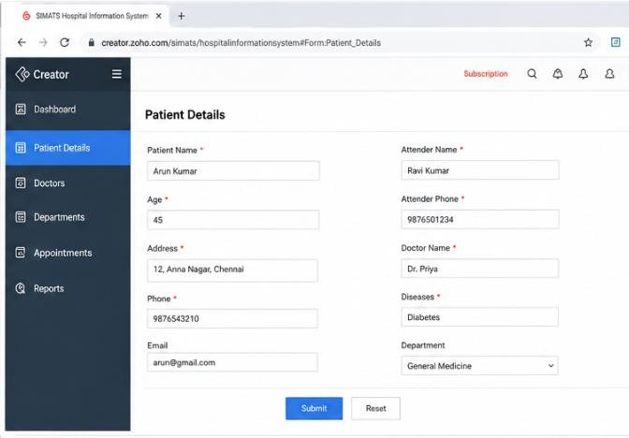
<td><button onclick="updateStatus('${pt.patientId}')">Update Status</button></td>`;
});
}
async function addPatient() { const patient = {
name: pname.value, age: age.value, address: address.value,
phone: phone.value, email: email.value, attName: attName.value, attPhone: attPhone.value, doctor: doctor.value, disease: disease.value, status: "Admitted"
};
await fetch(API, { method: "POST", body: JSON.stringify(patient) }); loadPatients();
}
async function updateStatus(id) {
await fetch(`${API}/${id}`, { method: "PUT", body: JSON.stringify({ status: "Discharged" }) }); loadPatients();
}
loadPatients();
</script>
</body>
</html>
Output Screenshot

Slide 6
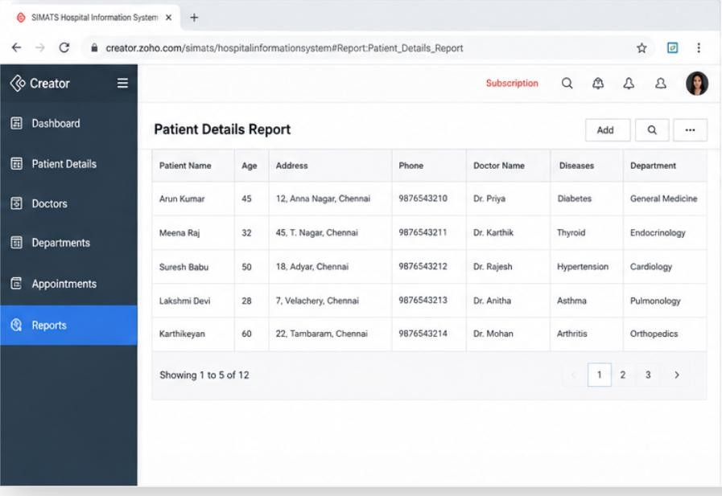
Fig 1.1 — Patient records output on the deployed SaaS application (Zoho Creator)
Result
A cloud-hosted Hospital Information System for SIMATS Hospital was successfully created and deployed as a SaaS application. The application allows registering patient records with attender and doctor details, and updating patient status (Admitted/Under Treatment/Discharged), all accessed through a public URL without any local installation.

Slide 7
Experiment 2: Online Super Market System (SaaS)
Aim
To design and deploy a simple cloud-based (SaaS) Online Super Market application using a Cloud Service Provider, allowing customers to register their details, browse item categories, and place orders with quantities, accessible over the internet through a browser.
Software / Cloud Resources Required
Cloud Service Provider account (AWS / Azure / GCP — Free Tier)
Static web hosting (Amazon S3 / Azure Static Web Apps / Firebase Hosting)
Serverless backend for order processing (AWS Lambda / Azure Functions / Firebase Cloud Functions)
Cloud database to store customer and order/item records (DynamoDB / Cosmos DB / Firestore)
Database Fields — Customer Order Table
Field Name | Data Type / Description
Order ID | String (Primary Key, auto-generated)
Customer Name | String
Address | String
Phone | String
Email | String
Item Name | String
Quantity | Number
Order Date | Date
Item Classification Form — Fields
Field Name | Data Type / Description
Item Code | String (Primary Key)
Item Name | String
Category | String — Grocery / Dairy / Vegetables / Fruits / Household / Beverages
Unit Price | Number (₹)
Unit of Measure | String — kg / litre / piece / packet
Stock Available | Number
Procedure
Create a free-tier account with the chosen Cloud Service Provider.
Create two cloud database tables: 'Items' (item classification, using Item Code as primary key) and 'Orders' (customer orders, using Order ID as primary key) with the attributes listed above.
Write a serverless function that allows adding items under a category (item classification form), listing items by category, and placing a customer order that reduces stock accordingly.

Slide 8
Expose the function as REST API endpoints using API Gateway (or equivalent) — one endpoint for items, one for orders.
Build the front-end web page shown below with two sections: an Item Classification form for the store admin, and a Customer Order form for shoppers.
Deploy the front-end to S3 Static Website Hosting (or Azure/Firebase Hosting) and enable public access.
Access the deployed URL, add sample items under different categories, then place a test customer order and verify that customer details, item, and quantity are stored correctly in the cloud database.
This confirms the SaaS delivery model — the super market application and its data are entirely cloud-hosted and reachable only through a browser.
Sample Front-End Code (market.html)
<!DOCTYPE html>
<html lang="en">
<head>
<meta charset="UTF-8">
<title>Online Super Market</title>
<style>
body { font-family: Arial, sans-serif; margin:30px; background:#f4f6f8; } h2, h3 { color:#1f4e78; }
.card { background:#fff; padding:20px; border-radius:6px; max-width:520px; margin-bottom:20px; } label { display:block; margin-top:10px; font-weight:bold; }
input, select { width:100%; padding:6px; box-sizing:border-box; }
button { margin-top:16px; padding:8px 16px; background:#1f4e78; color:#fff; border:none; }
</style>
</head>
<body>
<h2>Online Super Market</h2>
<div class="card">
<h3>Item Classification Form</h3>
<label>Item Code</label><input id="itemCode">
<label>Item Name</label><input id="itemName">
<label>Category</label>
<select id="category">
<option>Grocery</option><option>Dairy</option><option>Vegetables</option>
<option>Fruits</option><option>Household</option><option>Beverages</option>
</select>
<label>Unit Price (₹)</label><input id="price" type="number">
<label>Unit of Measure</label><input id="unit" placeholder="kg / litre / piece">
<label>Stock Available</label><input id="stock" type="number">
<button onclick="addItem()">Add Item</button>
</div>
<div class="card">
<h3>Customer Order Form</h3>
<label>Customer Name</label><input id="custName">
<label>Address</label><input id="address">
<label>Phone</label><input id="phone">
<label>Email</label><input id="email">
<label>Item Name</label><input id="orderItem">
<label>Quantity</label><input id="qty" type="number">
<button onclick="placeOrder()">Place Order</button>
</div>

Slide 9
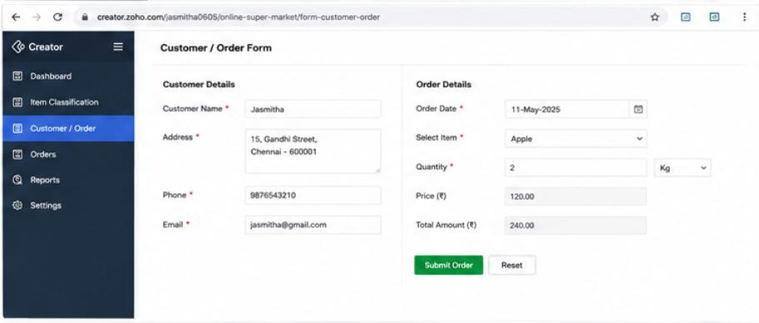
<script>
const ITEM_API = "https://<your-api-id>.execute-api.<region>.amazonaws.com/items"; const ORDER_API = "https://<your-api-id>.execute-api.<region>.amazonaws.com/orders";
async function addItem() { const item = {
itemCode: itemCode.value, itemName: itemName.value,
category: category.value, price: parseFloat(price.value), unit: unit.value, stock: parseInt(stock.value)
};
await fetch(ITEM_API, { method: "POST", body: JSON.stringify(item) }); alert("Item added under category: " + item.category);
}
async function placeOrder() { const order = {
custName: custName.value, address: address.value, phone: phone.value, email: email.value, itemName: orderItem.value, quantity: parseInt(qty.value)
};
await fetch(ORDER_API, { method: "POST", body: JSON.stringify(order) }); alert("Order placed successfully!");
}
</script>
</body>
</html>
Output Screenshot

Slide 10
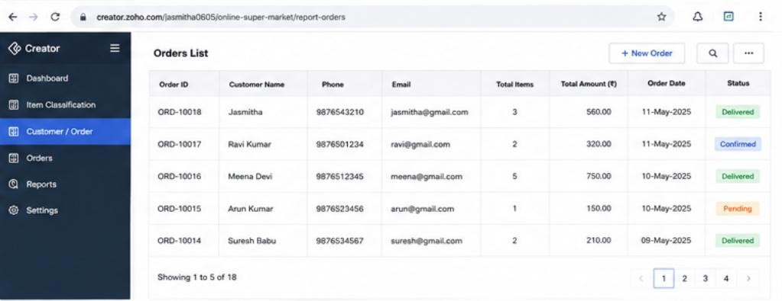
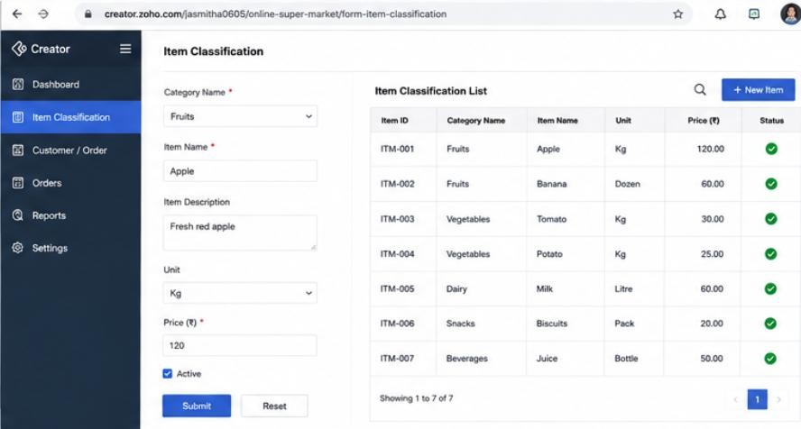
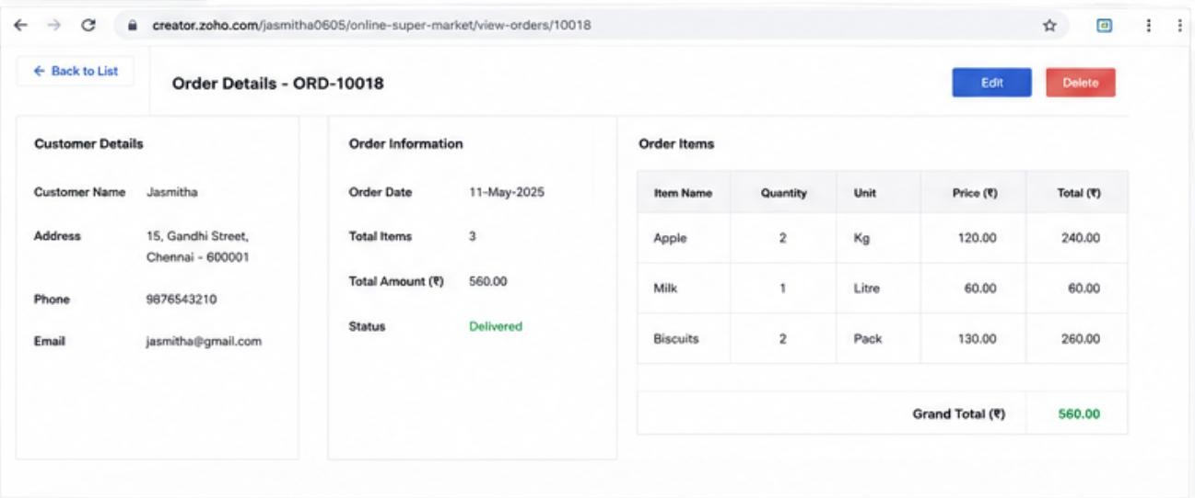

Slide 11
Fig 2.1 — Item classification and customer order output on the deployed SaaS application (Zoho Creator)
Result
A cloud-based Online Super Market application was successfully created and deployed as a SaaS application. Items could be added and classified by category through the Item Classification form, and customers could place orders with item and quantity details, all stored in a cloud database and accessed through a public URL without local installation.

Slide 12
Experiment 3: Creating a Virtual Machine using a Type-2 Hypervisor
Aim
To demonstrate virtualization by installing a Type-2 Hypervisor on the host machine and creating a Virtual Machine with 3 vCPUs, 10 GB RAM, and a 10 GB storage disk, configured with a guest operating system (Windows/Linux).
Software Required
Host machine with virtualization (Intel VT-x / AMD-V) enabled in BIOS/UEFI, and at least 4 physical/logical CPU cores and 12 GB+ RAM available
Type-2 Hypervisor: Oracle VirtualBox 7.x (or VMware Workstation Player)
Guest OS ISO image (e.g., Ubuntu Desktop/Server ISO, or Windows 10/11 ISO)
At least 12 GB free disk space on the host
Procedure
Enable virtualization support (Intel VT-x/AMD-V) in the host system's BIOS/UEFI settings.
Download and install Oracle VirtualBox (Type-2 Hypervisor) along with the VirtualBox Extension Pack on the host operating system.
Download the desired guest OS ISO image (e.g., Ubuntu Desktop) and save it on the host machine.
Open VirtualBox Manager and click 'New' to create a new virtual machine.
Enter a name for the VM (e.g., 'SIMATS-VM2'), select the Type (Linux/Windows) and Version matching the ISO chosen.
Set the Memory Size to 10240 MB (10 GB) as required, ensuring the host has enough free RAM remaining for itself.
Choose 'Create a Virtual Hard Disk Now', select VDI format, Dynamically Allocated, and set the size to 10 GB.
Select the newly created VM, go to Settings → System → Processor, and set the number of CPUs to 3.
Go to Settings → Storage, attach the downloaded ISO file to the virtual optical drive.
Start the VM; the guest OS installer boots from the attached ISO. Follow the on-screen steps to install the guest operating system onto the 10 GB virtual disk.
After installation completes, remove the ISO from the virtual drive and reboot the VM to boot from the virtual hard disk directly.
Verify the configuration from within the guest OS (System Info) confirming 3 CPUs, 10 GB RAM, and 10 GB disk, and install VirtualBox Guest Additions for better performance/integration.
Configuration Summary

Slide 13
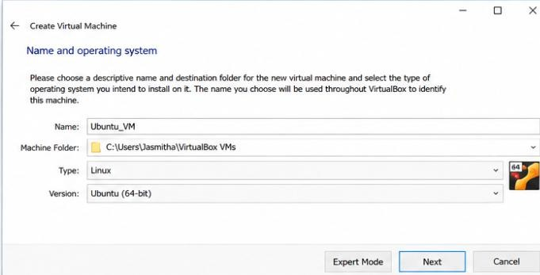
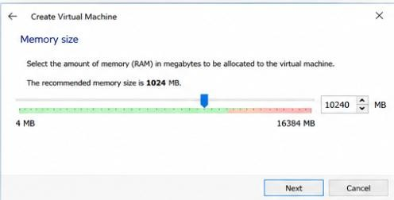
Parameter | Configured Value
Hypervisor Type | Type-2 (Hosted) — Oracle VirtualBox
Host OS | Windows / Linux (as installed on physical machine)
Guest OS | Ubuntu Linux / Windows (as selected)
vCPU | 3
RAM | 10 GB (10240 MB)
Storage Disk | 10 GB (VDI, Dynamically Allocated)
Output Screenshot

Slide 14







Create Y•rtval Machine
Processor
- Create Virtual I•Ia‹d Disk
File size
Please <nocce the site of the w‹ual hard au‹ flk The size of Line file a< your bard disk w•ii
uary cbpendñ>g on tf›e we or hard ask fde format that rou dxx se ar<I d›e way you use tfe vinud hera W.
UbuAtu VM • Sd•ItiPiqS
Display
Ubuntu,VN
Audña
' Network
•w • Ubuntu {64 -bit)
Shared Folders
User nterfaEe

Slide 15
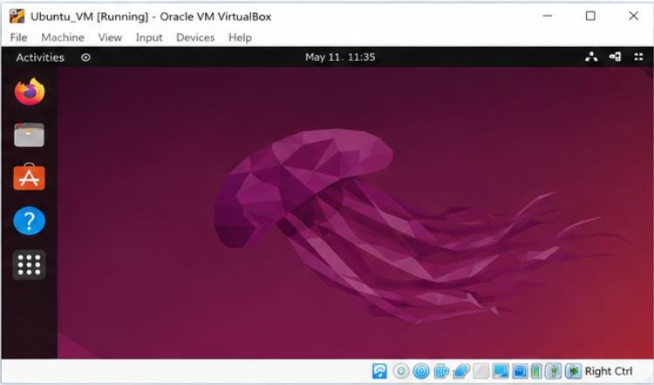
Result
A Type-2 Hypervisor (Oracle VirtualBox) was successfully installed on the host machine, and a Virtual Machine with 3 CPUs, 10 GB RAM, and 10 GB storage was created and configured with a guest operating system, demonstrating hardware virtualization with a higher-resource allocation on a hosted platform.

Slide 16
Experiment 4: Creating and Testing a Snapshot of a Virtual Machine
Aim
To demonstrate virtualization by creating a Snapshot of an existing Virtual Machine (created using a Type-2 Hypervisor) and testing it by restoring the VM to the previous saved version/state.
Software Required
Oracle VirtualBox (Type-2 Hypervisor) with the source VM from Experiment 3 already created and its guest OS installed
Sufficient free disk space on the host for storing snapshot delta files
Procedure
Start the source virtual machine (e.g., 'SIMATS-VM2') and boot into the guest operating system so it is in a known, working state.
In VirtualBox Manager, select the VM, open the 'Snapshots' tab (or Machine → Take Snapshot from the VM window).
Click 'Take Snapshot', enter a name (e.g., 'Base-State') and an optional description, then click 'OK'. This captures the current disk state, memory, and configuration of the VM at that point in time.
Make a noticeable change inside the guest OS after the snapshot — for example, create a new file, install a small application, or change the desktop background — so that the change can later be used to verify the rollback.
Optionally take a second snapshot (e.g., 'After-Change') to represent the modified state, so there are two versions to compare.
To test the snapshot, shut down the VM (Machine → Close → Power Off).
In the Snapshots tab, right-click the earlier snapshot ('Base-State') and select 'Restore Snapshot' to roll the VM back to that saved version.
Confirm the restore when prompted, then start the VM again and log in to the guest OS.
Verify that the change made in Step 4 (the new file/application/setting) is no longer present, confirming the VM has been successfully reverted to the previous snapshot's state.
This demonstrates the snapshot capability of Type-2 hypervisors, which allows quick save-and-restore of a VM's state without a full reinstall.
Observation Table
Snapshot | State Captured | Verification After Restore
Base-State | Clean guest OS, before any change | Restored VM does not show the later change
After-Change | Guest OS with the added file/application | Change is present only when this snapshot is active
Output Screenshot

Slide 17
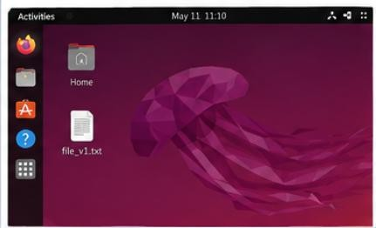
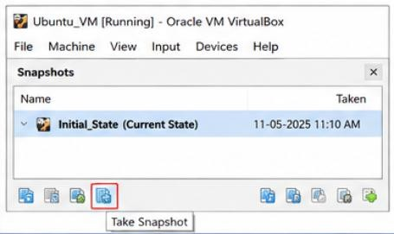
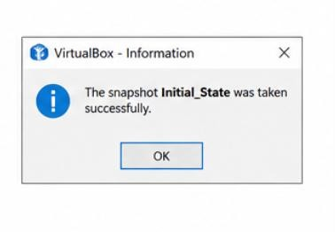
Fig 4.1

Slide 18
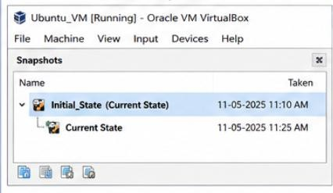
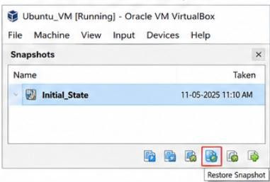
Result
A snapshot of the existing Virtual Machine was successfully created using the Type-2 Hypervisor's Snapshot feature. The VM was tested by restoring it to the previously saved snapshot, and the guest OS reverted correctly to its earlier state, demonstrating the save-and-restore (rollback) capability of virtualization platforms.

